Slide 1
LabVIEW直接build有管理員權限(Administrator)的執行檔(exe)
參考來源:
https://medium.com/@pohanliao_51051/labview-%E7%9B%B4%E6%8E%A5build%E6%9C%89%E7%AE%A1%E7%90%86%E5%93%A1%E6%AC%8A%E9%99%90-administrator-%E7%9A%84%E5%9F%B7%E8%A1%8C%E6%AA%94-exe-cb9c6a55a905

Slide 2
1.首先按右鍵新增一個TXT檔案，並在裡面寫入以下內容
<?xml version="1.0" encoding="UTF-8" standalone="yes"?>
<assembly xmlns="urn:schemas-microsoft-com:asm.v1" manifestVersion="1.0">
<assemblyIdentity version="1.0.0.0"
processorArchitecture="X86"
name=“你的程式名稱.exe"
type="win32"/>
<!-- Identify the application security requirements. -->
<trustInfo xmlns="urn:schemas-microsoft-com:asm.v2">
<security>
<requestedPrivileges>
<requestedExecutionLevel
level="requireAdministrator"
uiAccess="false"/>
</requestedPrivileges>
</security>
</trustInfo>
</assembly>

Slide 3
2. 把檔名改成
你的程式名稱.exe.manifest

Slide 4
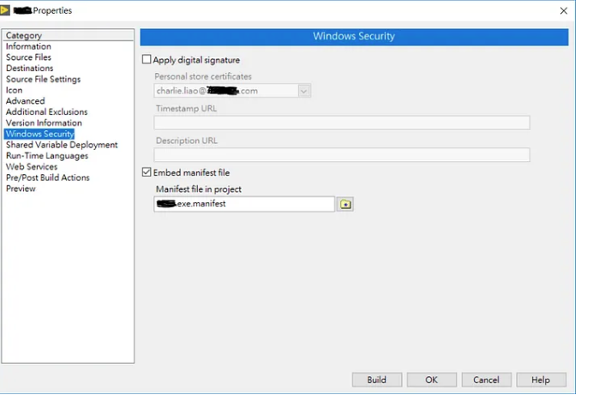
3. 接著在LabVIEW build執行檔的Properties > 左邊Windows Security，把Embed manifest file打勾，並選擇你剛剛新增的檔案。

Slide 5
